Slide 1
Female Black and White Paintings
Intoduction
The presentation in the slides is about paintings of women in black and white.It contains the descriptions of the art work and the artists who did it.

Slide 2
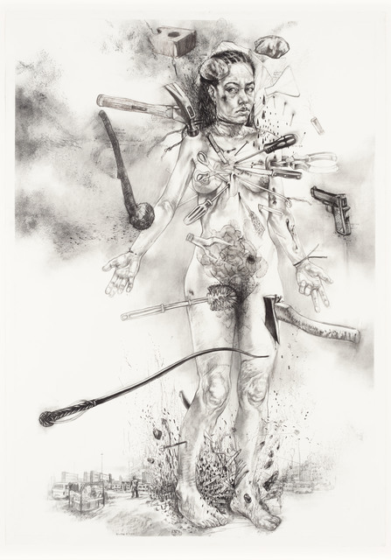
Female Black and White Paintings
Diane victor is a South African artist.
Her drawings and prints explore social injustices , war and corruption
.This is a wound woman painting done in 2017 by Diane
Wound woman painting

Slide 3
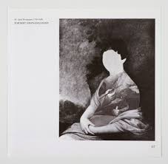
Female Black and White Paintings
Ewa’s Art work
Ewa Juszkkiewicz ‘s best known works are surrealist portrayals of women with fantastically deformed heads, transformed into proliferating polypore's, gigantic insect bodies, bouquets, tribal masks and draped tapestry.
She researches the phenomena of transgressing aesthetic norms and the various canons of portrayal.

Slide 4
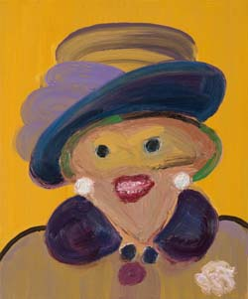
Female Black and White Paintings
Margaret Thatcha’s painting
Carla Bussutil is a British artist born in Johannesburg.
Her paintings depicted caricatured portrait of society that evoked public figures.

Slide 5
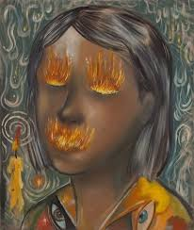
Female Black and White Paintings
Jakub Julian Ziółkowski took part in most important art events like the 55th Art Biennale in Venice.
He painted from his head without using photography or imagery news
The paintings he creates depict a seemingly chaotic microcosm, mysterious worlds inhabited by fantastic plants, insects and at times semi-human creatures that have two heads.
The Candle girl Painting

Slide 6
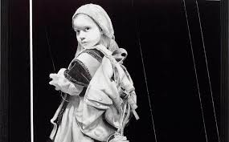
Female Black and White Paintings
Museum exhibition for Andrew Sendor
Andrew sendor was born in 1977.
His hyper realistic oil paintings include digitalized and pixelated images. The monochromatic (usually black and white) paintings and jpg files present imagined views of installations at invented exhibits.

Slide 7
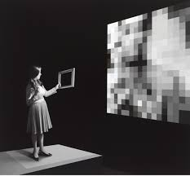
Female Black and White Paintings
Andrew Sendor, A view of the installation.
(left) Performance with The Grand Master Cryptologist;
(right) Onora Afua, Un-thinkable, 2033, video projections, 2012, oil on linen.

Slide 8
References
Belton, John. "Painting by the numbers: The digital intermediate." FILM QUART 61.3 (2008): 58-65.
Wollheim, Richard. "Painting as an Art." (1987).

